Slide 1

4/6 Report
By Bolun

Slide 2
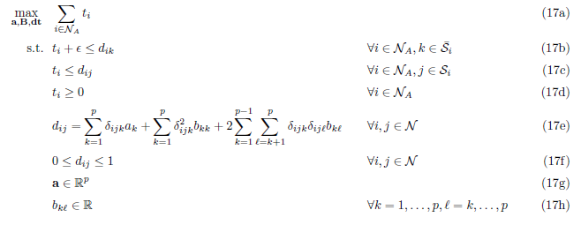
1.1 Original LP Metric Learning

Slide 3
Start
1.2 Fast LP Algorithm
with Row and Column Generation
Input Data
Initialize Matrix B
(eg. Euclidean Distance)
Initialize constraints
(Re)Solve LP
Check violation
Of constraints
Violation exist ?
Add relative constraints
Yes
No
Output Data
End

Slide 4
1.3 Time consumed
compare to the original LP method
Testing platform: x64 vs2013 c++
Data-set | Dimension | class | points | Time consumed (Original LP) | Time consumed (Fast LP)
 | d= |  | n= | t= (sec) | t= (sec)
Simple data | 2 | 2 | 20 | 0.115 | 0.112
syntheticNoOutliers | 2 | 3 | 300 | 26.90 | 6.18
Synthetic With Outliers | 2 | 3 | 198 | 3.69 | 1.81
Mnist(part) | 20 | 3 | 980 | >1.5hour | 1400s=23.3 min
CIFAR | 48 | 3 | 1497 | >>10 hour | <10 hour

Slide 5
Start
2.1 Iterative LP Algorithm 1 with Row and Column Generation
(outlier re-insertion outside the generations)
Input Data
Set epsilon
Solve fast LP
Delete Outliers from data
Outliers exist?
Yes
No
Yes
Re-insert outliers
Outliers changed?
No
End
Solve fast LP

Slide 6
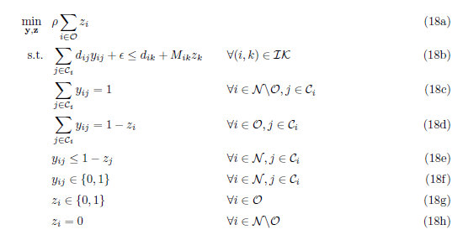
Re-insert outliers
Ri Method
MILP Method
Compute Ri of outliers
Put points back to data with largest Ri until we cannot put back any point

Slide 7
Start
2.2 Iterative LP Algorithm 2 with Row and Column Generation
(outlier re-insertion inside the loop)
Input Data
Initialize Matrix B
(eg. Euclidean Distance)
Initialize constraints
(Re)Solve LP
Create set of alleged outliers.
Add relative constraints
Check violation
Of constraints
Determine and reinsert outliers
Violation exist ?
Yes
Output Data
End
No

Slide 8
2.3 Time consumed
comparison between Algorithm 1 & 2
Testing platform: x64 vs2013 c++
Epsilon=1/2*Max_epsilon
Data-set | Dimension | class | points | Time consumed (Algorithm 1) | Time consumed (Algorithm 2)
 | d= |  | n= | t= (sec) | t= (sec)
simple | 2 | 2 | 20 | 0.96 | 0.26
syntheticNoOutliers | 2 | 3 | 300 | 41.47 | 8.43
Synthetic With Outliers | 2 | 3 | 198 | 9.25 | 3.69

Slide 9
2.4 Result
Comparison between Algorithm 1 & 2
In most of the cases, the result are the same.
In some cases with different epsilon, results turn out to be different.
For example:
Data-set | Dimension | class | points | Time consumed (Original LP) | Time consumed (Fast LP)
 | d= |  | n= | t= (sec) | t= (sec)
Simple data | 2 | 2 | 20 | 0.115 | 0.112

Slide 10
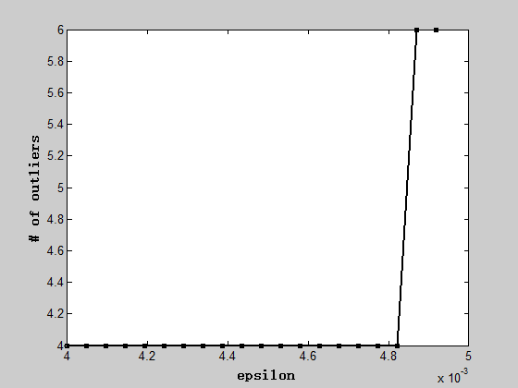
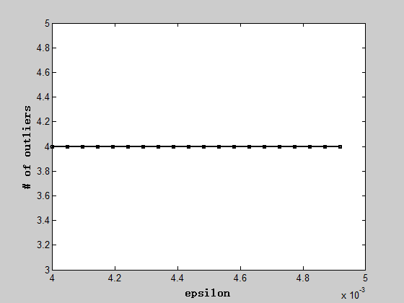
2.4 Result
Comparison between Algorithm 1 & 2
Data-set | Dimension | class | points | Time consumed (Original LP) | Time consumed (Fast LP)
 | d= |  | n= | t= (sec) | t= (sec)
Simple data | 2 | 2 | 20 | / | /
Trade-off curve:
Algorithm 1
Algorithm 2

Slide 11
2.4 Result
Comparison between Algorithm 1 & 2
Data-set | Dimension | class | points | Time consumed (Original LP) | Time consumed (Fast LP)
 | d= |  | n= | t= (sec) | t= (sec)
Simple data | 2 | 2 | 20 | / | /
Trade-off curve:
Algorithm 1
Algorithm 2

Slide 12
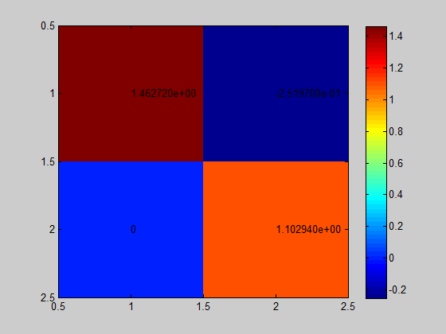
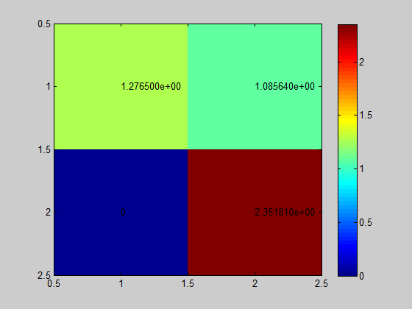
2.4 Result
Comparison between Algorithm 1 & 2
Data-set | Dimension | class | points | Time consumed (Original LP) | Time consumed (Fast LP)
 | d= |  | n= | t= (sec) | t= (sec)
Simple data | 2 | 2 | 20 | / | /
Distance Metric: (epsilon = max epsilon=0.0048)
Algorithm 1
Algorithm 2

Slide 13
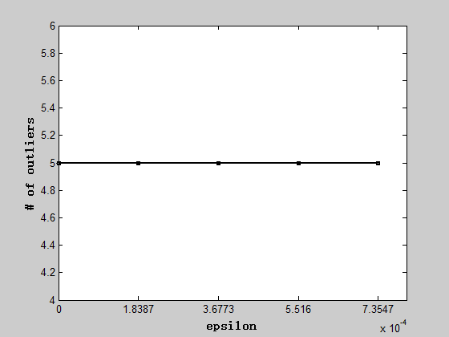
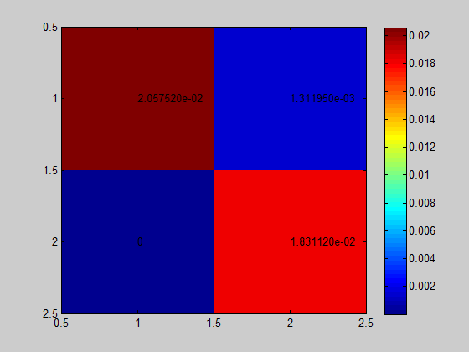
2.4 Result
Comparison between Algorithm 1 & 2
Another example:
Data-set | Dimension | class | points | Time consumed (Algorithm 1) | Time consumed (Algorithm 2)
 | d= |  | n= | t= (sec) | t= (sec)
Synthetic With Outliers | 2 | 3 | 198 | 9.25 | 3.69
Algorithm 1
=
Algorithm 2

Slide 14
3 Comparison with LMNN
Testing platform: x64 vs2013 c++
Epsilon=1/2*Max_epsilon
Data-set | Dimension | class | points
 | d= |  | n=
SyntheticWithOutliers | 2 | 3 | 198

Slide 15
3.1 Result from cross-validation experiment
(Algorithm2)
Testing platform: x64 vs2013 c++
Epsilon=1/2*Max_epsilon
Data-set | Dimension | class | points
 | d= |  | n=
Synthetic With Outliers | 2 | 3 | 198
 | Accuracy (Our method) | Accuracy (LMNN)
 | % | %
6 cross-validation | 8.08 | (not finished)

Slide 16
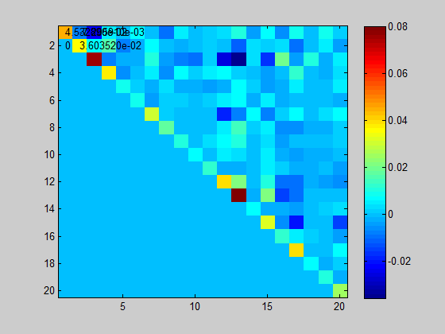
4.1 Other results obtained
Data-set | Dimension | class | points | Time consumed (Original LP) | Time consumed (Fast LP)
 | d= |  | n= | t= (sec) | t= (sec)
Mnist(part) | 20 | 3 | 980 | >1.5hour | 1400s=23.3 min
With Algorithm 2

Slide 17
4.2 Works to be done
Previous data are not good enough to plot Trade-off curve that shows growth of outliers. Find a good example.
Implement LMNN with synthetic data with outliers
Profile and optimize the code.

Slide 18
Thank you !

